Slide 1
MC496251 - Retirement of Teams apps based on selected app-templates
We will be retiring the apps based on the following Teams App Templates - Poll, Survey, Checklist, Quiz and Training. Check the app store for alternate options.
Note: If your organization is not using Teams App Templates you can safely disregard this message.
[When this will happen:]
The applications will be active until 10th February. Users will be able to retrieve any data until 10th March. On 10th March, the applications will be fully retired.
[How this will affect your organization:]
If your organization is using Teams App Templates for any of the following - Poll, Survey, Checklist, Quiz and Training, the apps will stop functioning after the date of retirement.
[What you need to do to prepare:] You can request your users to download any data from the option available within the apps before the date of retirement. Note, the above retirement has no impact on the Polls app in teams. For further information you can reach out to ActionServiceSupport@microsoft.com.

Slide 2
Which App-templates are retiring?
MC Post MC-496251, refers to the retirement of following Teams App Templates :
Survey: https://github.com/OfficeDev/microsoft-teams-apps-survey
Poll: https://github.com/OfficeDev/microsoft-teams-apps-poll
Training: https://github.com/OfficeDev/microsoft-teams-apps-training
Quiz: https://github.com/OfficeDev/microsoft-teams-apps-quiz
Checklist: https://github.com/OfficeDev/microsoft-teams-app-checklist

Slide 3
How to find the Teams apps corresponding to these Templates?
Like any other app template, these apps are not available in Teams by default. Someone from your org must have downloaded the template from GitHub and sideloaded or published the apps for your Org.
Very few app properties are visible in the Teams admin center, and all those properties are configurable by the app developer while customizing the app template. Hence, it is little difficult to find the apps created using the specified app templates.
One way to find the Teams apps created using these templates in your org, is explained in following slides:

Slide 4
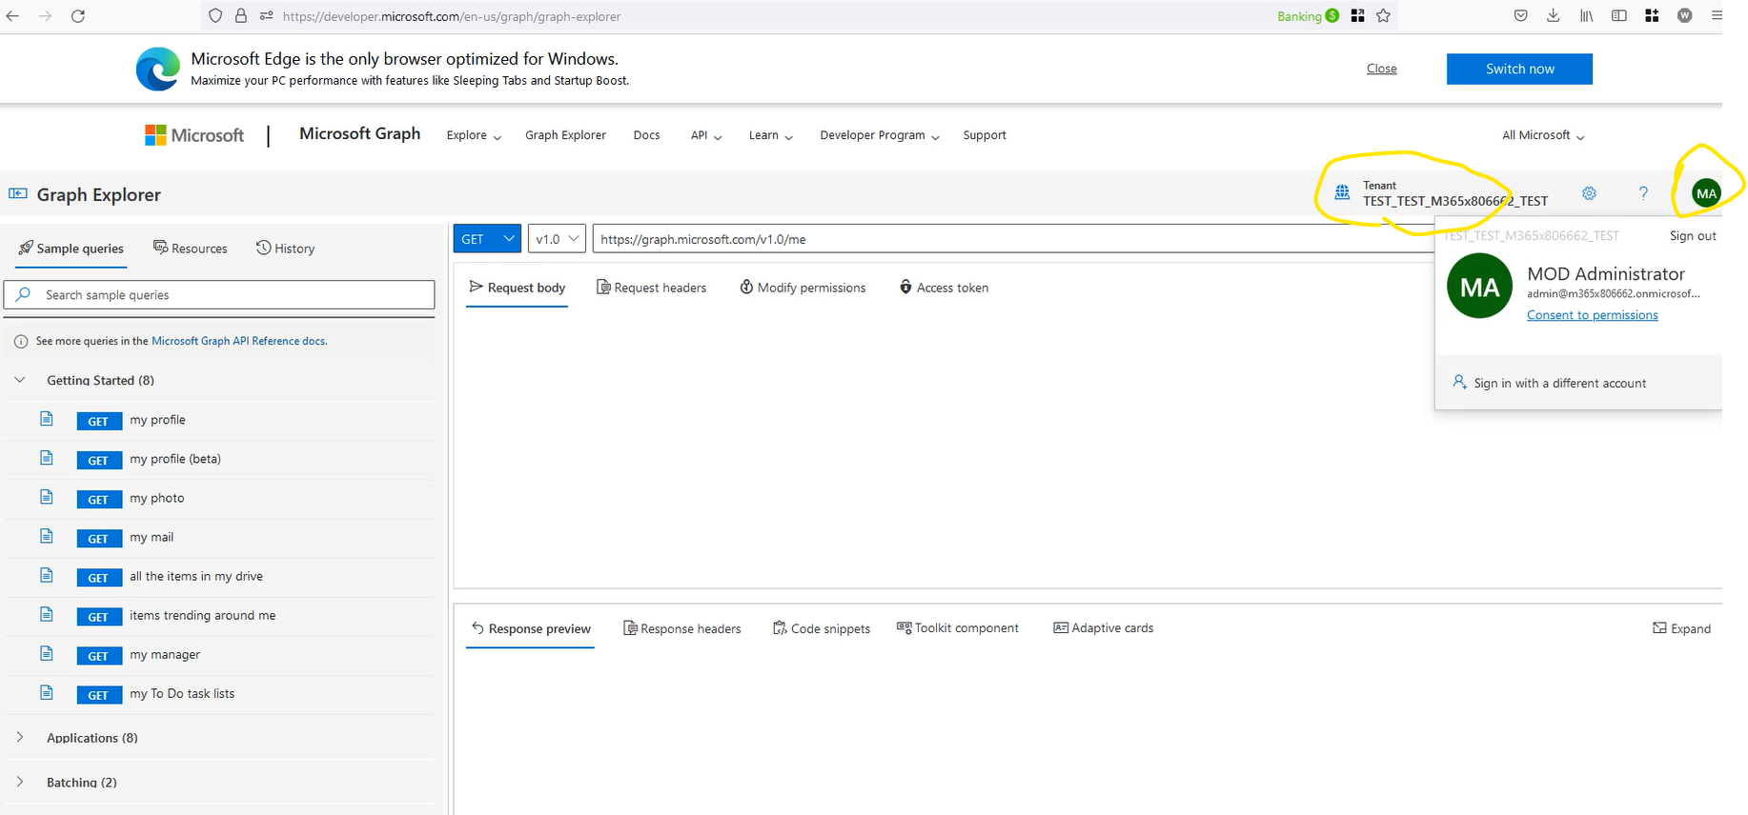
Step 1: Open Microsoft graph API explorer using this link:
https://developer.microsoft.com/en-us/graph/graph-explorer
Login with your Org credentials.

Slide 5
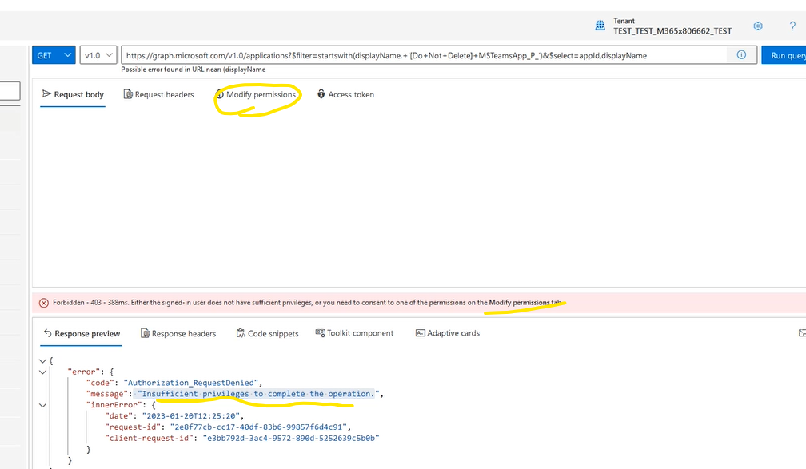

Step 2: Run following API to get all AAD applications created for Poll, Survey, Checklist, Quiz and Training App-templates:
Get https://graph.microsoft.com/v1.0/applications?$filter=startswith(displayName,+'[Do+Not+Delete]+MSTeamsApp_P_')&$select=appId,displayName
Step 2.a Graph API explorer needs “Application.Read.All” permission to invoke this Graph API. If not already consented for this permission, you will see following error message.
If you do not see such error, move to Step 2.d in the subsequent slides.

Slide 6
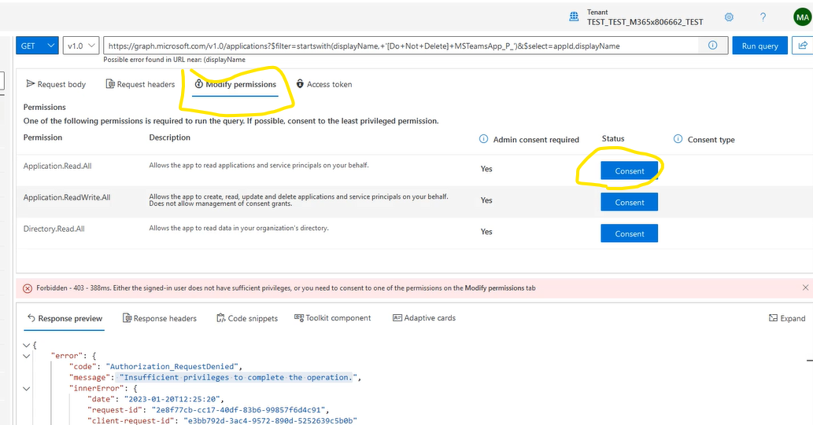
Step 2 continued ..
Step 2.b
- Navigate to “Modify permissions” tab as shown in this screenshot.
- Click on the Consent button corresponding to the “Application.Read.All” permission.

Slide 7
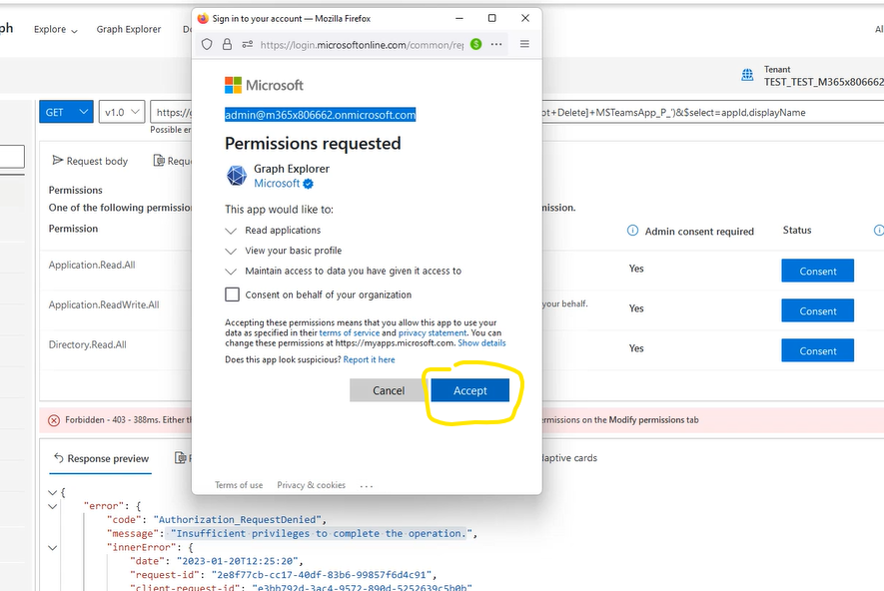
Step 2 continued ..
Step 2.c
On the pop-up window, click Accept button to provide the consent. This will grant “Application.Read.All” delegated permission to “Graph API explorer” App.

Slide 8
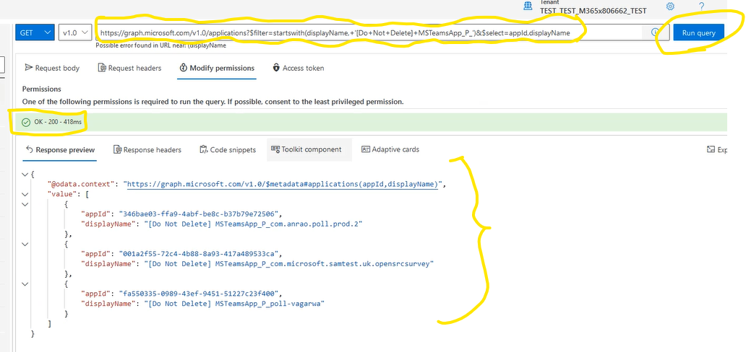
Step 2 continued ..
Step 2.d
After granting consent, click on “Run query” button to execute the API.
Case 1: Query executed successfully, with status OK – 200. And “value” list in the response is empty array. This means there are no apps created in your Org using the mentioned app-templates. No further action required in your tenant.
Case 2: Query executed successfully, with status OK – 200. And “value” list in the response is non-empty array, as shown in this screenshot.
Copy all the appIds in the response and run Step 3 for each appId.
Case 3: Query execution status is not 200.
Follow Microsoft graph API documentation to resolve the error.

Slide 9
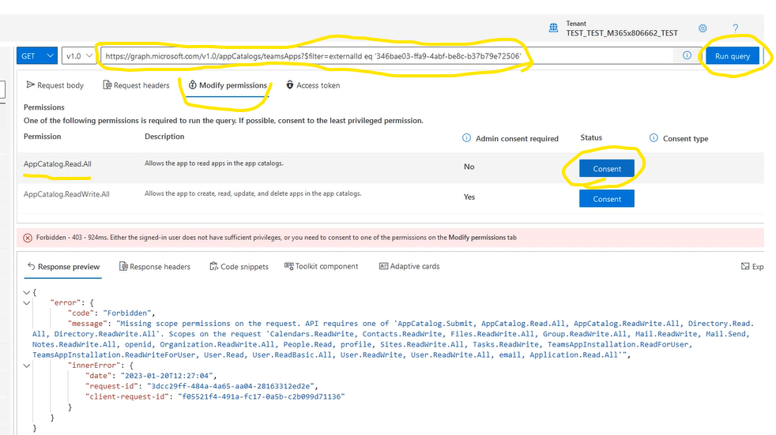
Step 3: Run following API for each AppId obtained in step 2.
Get https://graph.microsoft.com/v1.0/appCatalogs/teamsApps?$filter=externalId eq '<app id obtained in Step 2>'
You need to provide “AppCatalog.Read.All” permission in order to execute this API.
You can provide the permission as explained in Step 2.

Slide 10
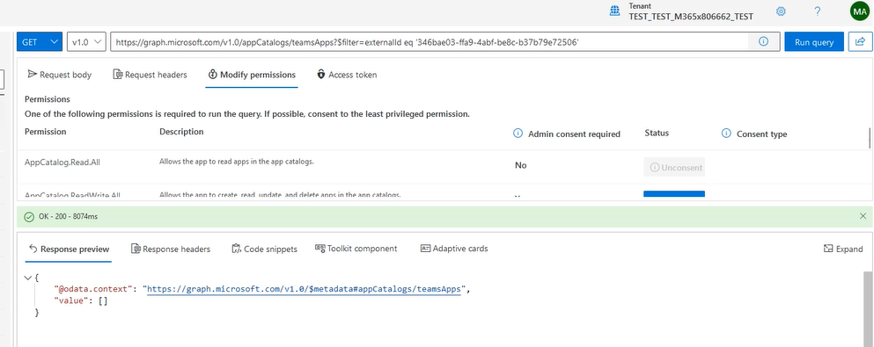


Step 3 continued ..
Case 1:
API executed successfully. Value array in the response is empty.
This means there is no Teams app present corresponding to this AAD app.
No action required for this AppId.
Repeat step 3 for next AppId found in Step 2.

Slide 11
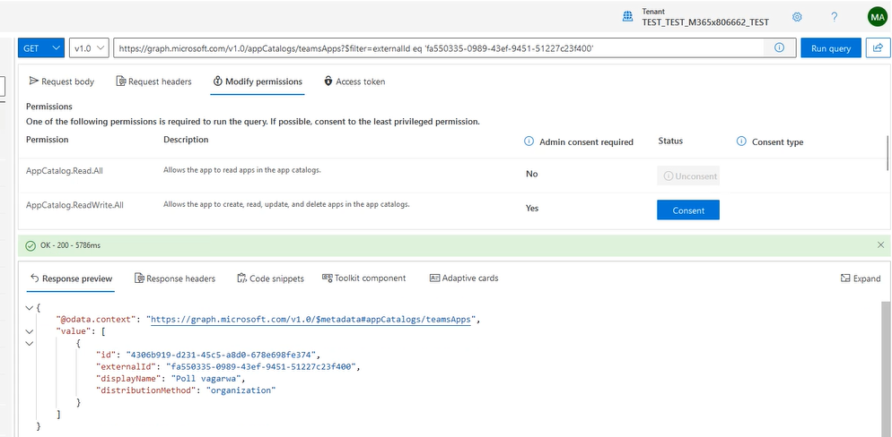
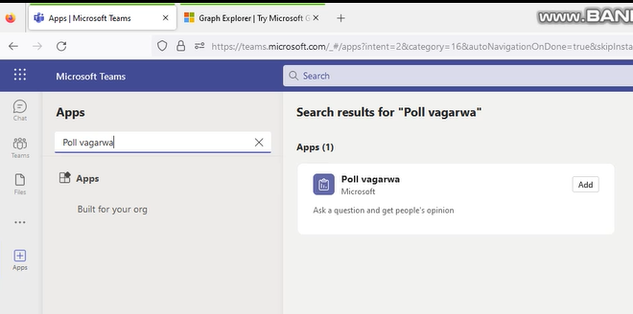







Step 3 continued ..
Case 2:
API executed successfully.
displayName in the response is name of the app in Teams.
You can search the app in Teams with the displayName.
Repeat step 3 for next AppId found in Step 2.

